Slide 1
Final Capstone Project
- Haripriya Mogili

Slide 2
Introduction
I live in Franklin, WI, a suburb city of Milwaukee, WI.
We do not have many good Indian restaurants.
Our dream has been to open an authentic one of a kind Indian Restaurant ourselves.
Factors that need to be considered
  Location
  Menu
  Hours
  Marketing
  Delegation
  Licensing/Permits

Slide 3
Problem Definition
"What is the best location to open my dream "Indian restaurant" in/around Milwaukee, WI?"

Slide 4
Data Required
Web scraping from the website mentioned below and gather some demographic information about Indian population in Wisconsin, especially in and around Franklin city, WI.
Web Reference :http://zipatlas.com/us/wi/city-comparison/percentage-indian-population.htm
Competitor Analysis: Use Foursquare Location data to collect data related to existing Indian restaurants in the locations of interest. Gather information related to existing Indian restaurants in Milwaukee and analyze their ratings and locations.
Clean and analyze required data from both these sources.
Use KNN clustering algorithm to determine top 3 locations to open my dream Indian restaurant.

Slide 5
Methodology
Step 1: I found out Indian demographic information in Wisconsin from this website
http://zipatlas.com/us/wi/city-comparison/percentage-indian-population.htm Using Beautiful Soup, we can scrape the needed Indian demographic information in Wisconsin. I could get all the cities with high Indian population in Wisconsin in descending order. I collected the name of all the top 25 cities in Wisconsin with highly populated Indian community.
Step 2: Using the necessary libraries, I found the latitudes and longitudes for these top 25 cities in Wisconsin with high Indian population.
Step 3: Since my family lives in Franklin, WI, I wanted to calculate the distance of these top 25 cities in WI from Franklin, WI and the dataframe shows the cities and their distances from Franklin, WI in ascending order. I used the Haversine formula to calculate distance between Franklin and other cities using their latitudes and longitudes respectively.
Step 4: I picked the top 14 city locations that were closest to Franklin,WI and also had high Indian population as my areas of interested locations in Wisconsin.
Step 5: Using my client ID and client secret, I gathered all venues from Foursquare Location data using the search query "Indian". I then filtered out only the Indian restaurants in my areas of interested locations in/around Franklin, WI. I had to run the search query with each of the interested locations latitude and londgitude. Since, the radius overlaps for these locations, I dropped all the duplicates and created a dataframe with all the unique Indian restaurants in the interested locations.

Slide 6
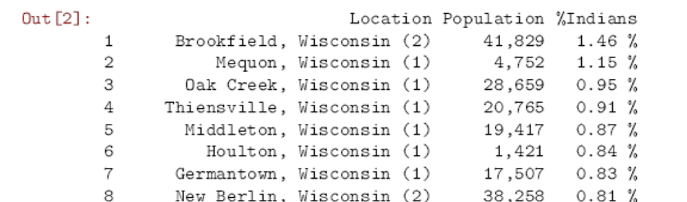
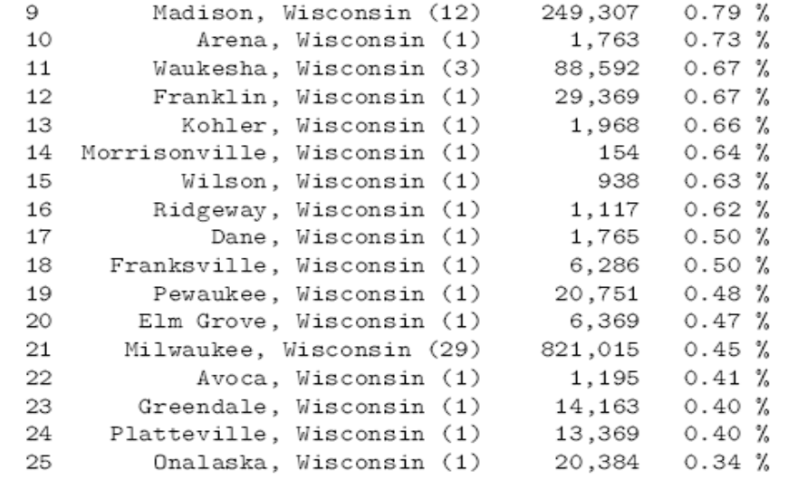
Cities in Wisconsin with High % of Indians

Slide 7
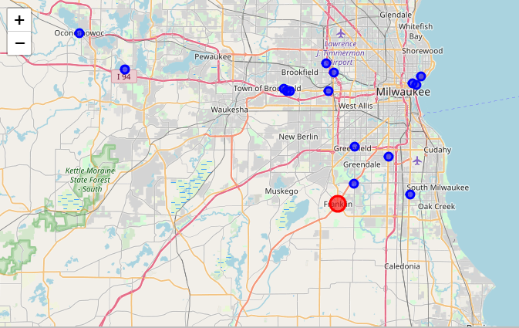
Location of Indian Restaurants in/around Franklin, WI – Using Foursquare Location Data

Slide 8
Methodology - Continued
Step 6: I plotted the location of these Indian restaurants with respect to Franklin, WI using the Folium library
Step 7: I also calculated the number of restaurants in each of these interested locations based on the venue address. I plotted this information as a bar graph. As you can see from the bar graph, though there are cities with high Indian population, there are little or no Indian restaurants. Most restaurants seemed to be in the city of Milwaukee, WI which is the downtown area even though Milwaukee ranks 11th in Indian population within Wisconsin. Another reason for more restaurants at Downtown area is due to recreations spots and businesses and Universities. These could contribute to high traffic. Since I live in this area, I know my results match the reality.
Step 8: I also calculated the average rating of these Indian restaurants using Foursquare Location data API. Few of these Indian restaurants were not rated and hence the average was just 7.6.
Step 9: I have collected required data in 2 dataframes.The first dataframe gives me the top 11 interested locations with high Indian population in/around Franklin, WI. My second dataframe had the number of Indian restaurants in each of these interested locations. I merged these two dataframes to create my final dataframe on which I wanted to run the KNN Clustering algorithm. The columns in the final dataframe has Ranking based on Indian Population|No of Indian Restaurants Latitude|Longitude|Distance from Franklin City(Miles). I dropped all other columns that had string values, since to run the "KNN clustering algorithm", all values must be numbers.

Slide 9
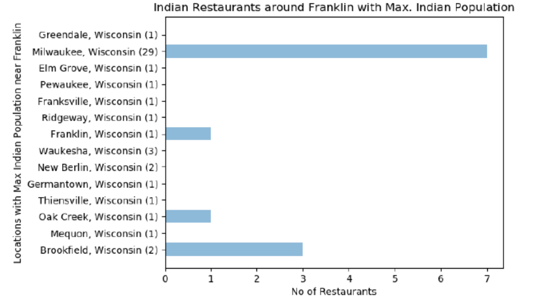
Current Indian Restaurants

Slide 10
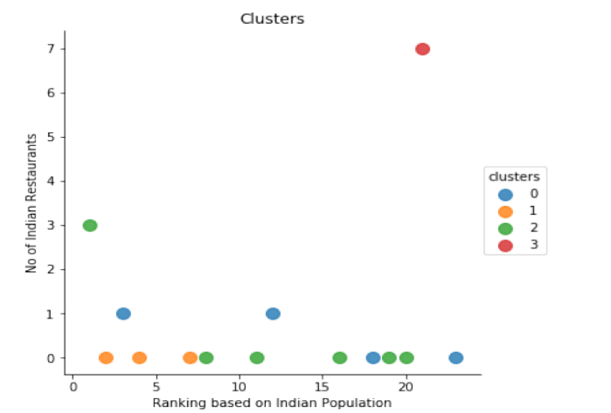
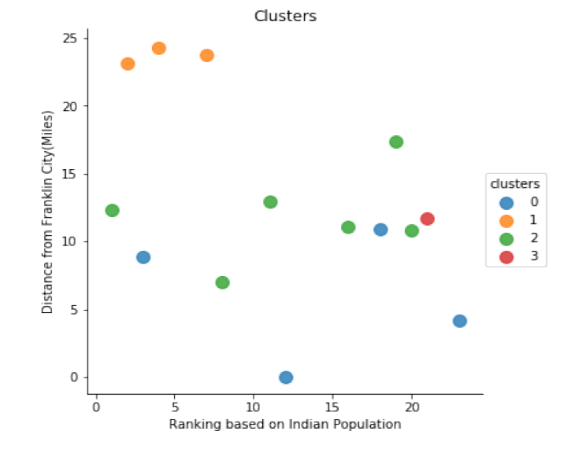
Methodology - Continued
Step 10: I ran the KNN algorithm with cluster size = 3, 4 and 5. I chose to keep the cluster size = 4, since it gave the most sensible results. I plotted 2 graphs of these clusters. The first graph shows the relationship between No of Indian Restaurants wrt to Ranking of Indian Populated Cities in/around Franklin, WI. The second graph shows the relationship between Ranking of Indian Populated Cities in/around Franklin, WI and their distance from Franklin, WI.
Step 11: I plotted a location map that showed the top 4 best locations that came as a result of the KNN clustering algorithm in/around Franklin, WI

Slide 11
Results
The average rating of the Indian restaurant was 7.6.
Cities in/around Franklin, WI that had high Indian population have little or no Indian restaurants.
The clustering algorithm could help me break it down into 4 categories
  High % Indian Population - No Indian Restaurant - Farthest from Franklin, WI
  Low % Indian Population - More Indian Restaurants- Midway from Franklin, WI
  Middle % Indian Population - Low Indian Restaurants - Closest to Franklin, WI
  Middle % Indian Population - Low Indian Restaurants - Midway to Franklin, WI

Slide 12
Conclusion
Since, the avg. user rating for Indian restaurants was only 7.6. This makes it desirable to start an Indian Restaurant with high rating.
Another motivating factor is that knowing the demographics of Indian population in the cities around Franklin, WI has shown that we have shortage of Indian restaurants in the right places. Cities with high Indian population have little or no Indian restaurants.

Slide 13
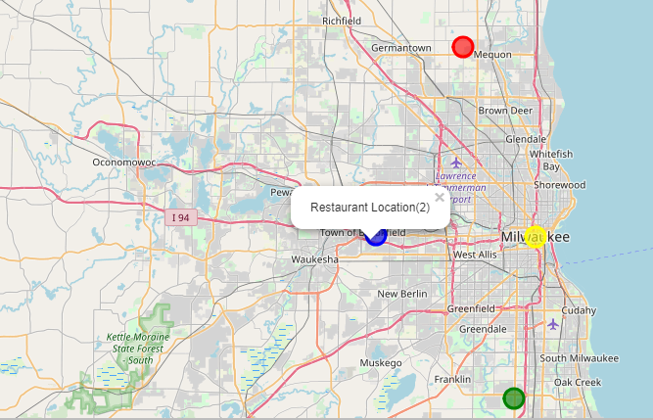
Top 4 Locations for Indian Restaurants
( Red Dot – First, Blue Dot – Second, Green Dot- Third, Yellow Dot – Fourth)

Slide 14
Conclusion
First Location(Mequon, WI) – far away from home
Second Location(Brookfield,WI) – my first choice
Third Location ( Franklin, WI) – my second choice
Fourth Location (Milwaukee, WI) – has enough Indian Restaurants
Data Analysis results match with reality
Clean, useful data with appropriate machine learning algorithms for data analysis will yield dependable results to make good business decisions.
Python language has also been quite easy and efficient to do all this project work.

Slide 15
Project Improvements
More demographic information about my interested cities in/around Franklin, WI like crime rates, median household income, number of businesses, etc could help me decide what kind of Indian restaurant I would like to open like Fine Dining, Lunch buffet, Fast food, Brunch, etc.
If I could get details about Venue menus from Foursquare, I could pick a unique, stand-out menu for my Indian restaurant.
Also, if I could find high traffic areas in my interested location, it could narrow my radius to choosing the best location.
I could also use trending venues at different times of the day to help me narrow my best location.
There are also lot more details you can collect about each venue from Foursquare that can help the algorithm perform better.

